Slide 1
Virtual Machines

Slide 2
IaaS Cloud Services
Azure VMs are on-demand, scalable computing resources.
Part of IaaS
IaaS is an instant computing infrastructure, provisioned and managed over the internet.

Slide 3
Business Scenarios
Test and Development
Website Hosting
Storage, Backup and Recovery
Web Apps
High Performance Computing
Big Data Analysis
Extended Datacenter

Slide 4
Planning Checklist
Start with the network
Name the VM
Decide the location of VM
Determine the size of VM
Pricing Model
Storage for the VM
Select the Operating System

Slide 5
Name the VM
Element | Example
Environment | Dev, prod, QA
Location | Uw, ue
Instance | 01,02,03,04,05,06,07
Product or Service | service
Role | Sql, web, messaging
Devusc-webvm01 – First development web server hosted in US South Central

Slide 6
Location
The location can limit your available options
There are price differences between location

Slide 7
Pricing
Compute Cost – Per-minute basis
Consumption Based – Pay As You Go
Reserved Instance – Reserve VM for 1 year or 3 year.
Storage Cost – Storage that VM uses.

Slide 8
Virtual Machine Sizing
General Purpose
Compute Optimized
Memory Optimized
Storage Optimized
GPU
High Performance Compute
Note: Be cautious when resizing the production VMs, it leads to a small amount of downtime

Slide 9
Virtual Machine Disk
OS Disk
Temporary Disk – Non-persistent
Data Disk

Slide 10
Supported OS
Windows
Linux

Slide 11
Creating and Connect to the VM
Windows RDP – 3389
Linux SSH - 22

Slide 12
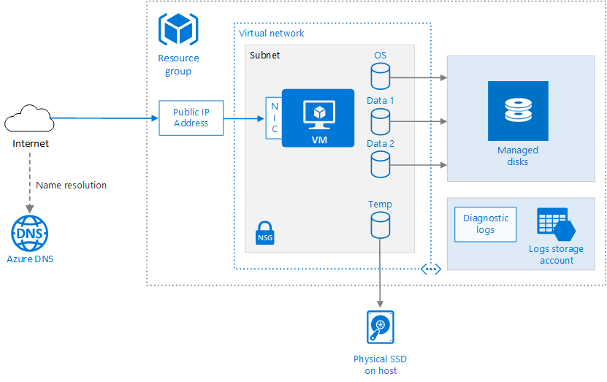

Slide 13




Stopping the VM
Closing the RDP
Shutdown
Disconnect
Stop using Powershell
Stop Using CLI
Stop Using Azure Portal
Deallocate

Slide 14
Troubleshooting
Ensure VM image is correct
Check the ports RDP for Windows and SSH for Linux are enabled
Check the IP Address

Slide 15
Virtual Machine Availability

Slide 16
Maintenance and Downtime
Unplanned Hardware Maintenance – Azure platform predicts hardware is about to fail
Unexpected Downtime – Local failure, disk failure, natural disaster
Planned Maintenance – Periodic maintenance from microsoft

Slide 17



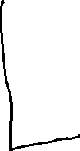





Availability Sets
A logical feature used to ensure that a group of related VMs are deployed so that they are not all subjected to single point of failure.

Slide 18











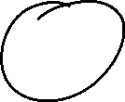


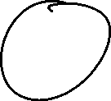











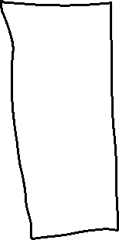







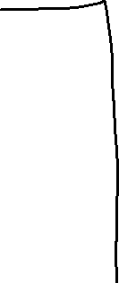






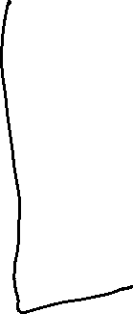


Slide 19
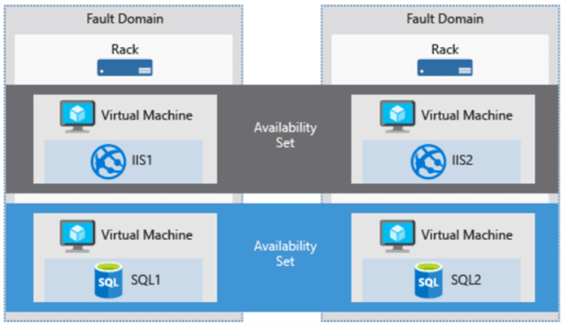

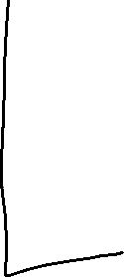
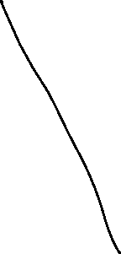
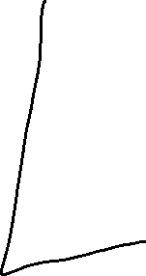

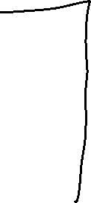

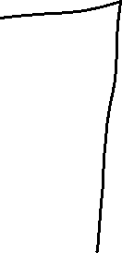










Slide 20
SLA
Single VM with a Premium Disk – 99.90%
Availability Set – 99.95%
Availability Zone – 99.99%

Slide 21
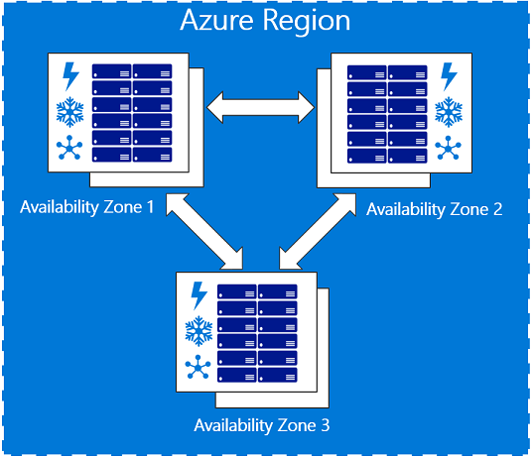
Availability Zone
Prevent from Data Center level failure
At min 2 VMs

Slide 22




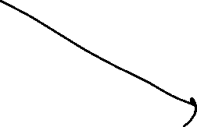


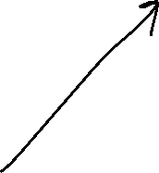
Virtual Machine Scale Set
Azure compute resource you can use to deploy and manage a set of identical VMs.
True auto scale, no pre-provisioning of VMs required.

Slide 23
Benefits of VMSS
Same base OS image and configuration
Azure load balancer – layer 4 and application gateway – layer 7
Scale set allows to run multiple instances of application
Customer demand can be met
Scale set supports upto 1000 VMs instances.

Slide 24
Autoscale
Scale In
Scale Out
Schedule events
Less overhead

